Slide 1
Analyzing Factors Affecting Academic Performance
A Regression Analysis Study
Submitted by: Sudipta Sarkar

Slide 2
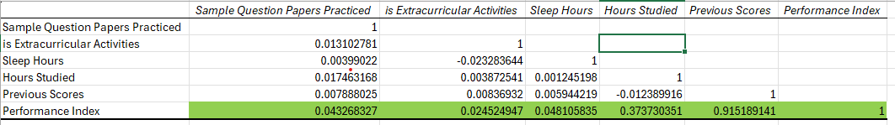
EXPLORATORY DATA ANALYSIS
CORRELATION MATRIX
The correlation matrix illustrates that:
Sample Question Papers Practiced (0.043 with Performance Index) has a very weak positive correlation. Practicing sample questions has little direct impact on performance, but it may still help in other indirect ways.
Extracurricular Activities (0.025 with Performance Index) has a Minimal correlation, which means participating in extracurricular activities has little direct impact.
Sleep Hours (0.048 with Performance Index) has a slightly positive correlation, suggesting that better sleep may contribute to performance, but not significantly.
Hours Studied (0.374 with Performance Index) has a moderate positive correlation, meaning more study hours generally lead to better performance, but not as strongly as previous scores
Previous Scores (0.915 with Performance Index) has a strongest positive correlation. It suggests that past performance is a strong predictor of future performance.

Slide 3
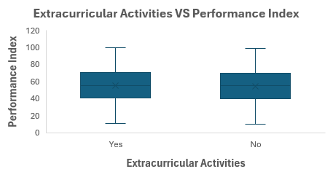
EXPLORATORY DATA ANALYSIS
Extracurricular Activities vs. Performance Index (Box Plot) : The box plot shows that participation in extracurricular activities has minimal impact on performance, as both groups have similar distributions.
Sleep Hours vs. Performance Index (Scatter Plot):)The scatter plot indicates little correlation between sleep duration and performance, suggesting other factors are more influential.
Sample Question Papers Practiced vs. Performance Index (Scatter Plot): This scatter plot reveals a weak relationship, as performance scores remain widely spread regardless of the number of sample papers practiced.

Slide 4
EXPLORATORY DATA ANALYSIS
Previous Scores vs. Performance Index (Scatter Plot) : A strong positive linear trend in the scatter plot suggests that past academic performance is the best predictor of future success.
Hours Studied vs. Performance Index (Scatter Plot) : The scatter plot shows a moderate positive correlation, indicating that studying more helps, but its impact is not as strong as previous scores.

Slide 5
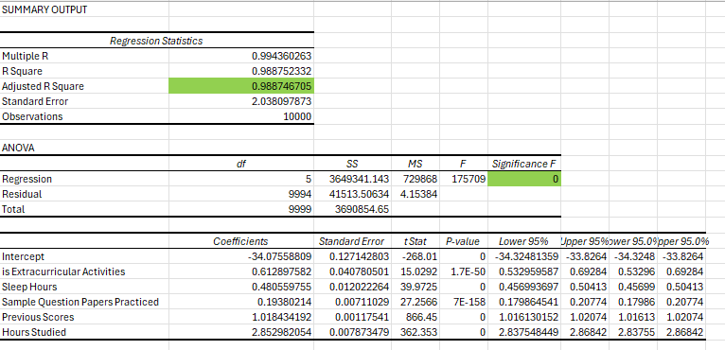
REGRESSION ANALYSIS
INSIGHTS: Adjusted R Square (0.9887): Indicates that 98.87% of the variance in performance is explained by the independent variables. Significance F (0): Suggests the overall model is highly significant. Previous Scores Matter Most: Strong predictor of future performance. Studying More Helps: Hours studied have a high positive impact. Practicing Sample Papers Has a Small Impact: May help but not as much as studying overall. Sleep is Beneficial: Though a small effect, adequate sleep contributes to performance. Extracurricular Activities Help: Engagement in activities outside academics also has a positive effect.

Slide 6
Linear Regression Model: Predicted Performance Index = -34.08+ 0.61*is Extracurricular activities +0.48*Sleep Hours+ 0.19* Sample question paper praccticed + 1.02* Previous scores + 2.85* Hours studied
This is a Residual Plot, which shows the residuals (errors) of the model against the predicted performance index. The residuals appear randomly scattered around zero, indicating that the model has captured most of the patterns in the data without systematic bias. No clear trend or pattern suggests that the assumptions of linear regression hold well.
THANK YOU

